Slide 1

YSC2239 Lecture 5

Slide 2
Recap
Understanding Data
Useful table functions: select, sort, where, drop, show, take, with_column, plot, group, bar/barh
https://github.com/data-8/datascience/blob/8d3fb1e0791b9e072c741b6d9c8efc98d554159e/datascience/tables.py

Slide 3
Today’s class
Binning and Histogram
Functions
Apply
Group
Join
Reading: Chapter 8

Slide 4
Binning Numerical Values
Binning is counting the number of numerical values that lie within ranges, called bins.
Bins are defined by their lower bounds (inclusive)
The upper bound is the lower bound of the next bin
188, 170, 189, 163, 183, 171, 185, 168, 173, ...
The [185,190) bin
160
165
170
175
180
185
190

Slide 5
Histogram
Chart that displays the distribution of a numerical variable
Uses bins; there is one bar corresponding to each bin
Uses the area principle:
The area of each bar is the percent of individuals in the corresponding bin
(Demo)

Slide 6
Defining Functions

Slide 7
Def Statements
User-defined functions give names to blocks of code
Name
Argument names (parameters)
def spread(values):
return max(values) - min(values)
Return expression
Body
(Demo)

Slide 8
Apply with Multiple Columns

Slide 9
Apply
The apply method creates an array by calling a function on every element in one or more input columns
First argument: Function to apply
Other arguments: The input column(s)
table_name.apply(one_arg_function, 'column_label')
table_name.apply(two_arg_function,
'column_label_for_first_arg',
'column_label_for_second_arg')
apply called with only a function applies it to each row
(Demo)

Slide 10
Grouping by One Attribute

Slide 11
Grouping by One Column
The group method aggregates all rows with the same value for a column into a single row in the resulting table.
First argument: Which column to group by
Second argument: (Optional) How to combine values
len — number of grouped values (default)
list — list of all grouped values
sum — total of all grouped values
(Demo)

Slide 12
Lists

Slide 13
Lists are Generic Sequences
A list is a sequence of values (just like an array), but the values can have different types
[2+3, 'four', Table().with_column('K', [3, 4])]
Lists can be used to create table rows.
If you create a table column from a list, it will be converted to an array automatically
Built into python (you don’t need numpy.)
(Demo)

Slide 14
Cross-Classification

Slide 15
Grouping By Multiple Columns
The group method can also aggregate all rows that share the combination of values in multiple columns
First argument: A list of which columns to group by
Second argument: (Optional) How to combine values
(Demo)

Slide 16
Pivot Tables

Slide 17
Pivot
Cross-classifies according to two categorical variables
Produces a grid of counts or aggregated values
Two required arguments:
First: variable that forms column labels of grid
Second: variable that forms row labels of grid
Two optional arguments (include both or neither)
values=’column_label_to_aggregate’
collect=’function_to_aggregate_with’
(Demo)

Slide 18
Group or Pivot?
Distribution of one categorical variable → .group()
Cross-classification of two or more categorical variables:
One row per combination → .group()
One variable vertically, one horizontally → .pivot()

Slide 19
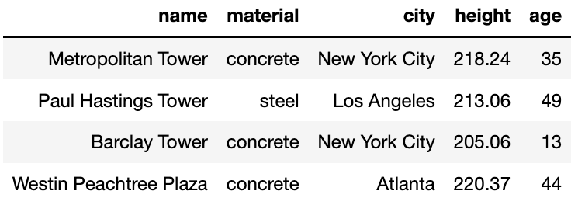
Challenge Question
For each city, what’s the height of the tallest building for each material?
For each city, what’s the height difference between the tallest steel building and the tallest concrete building?
sky
(Demo)

Slide 20
Joins

Slide 21
Joining Two Tables
drinks.join('Cafe', discounts, 'Location')
Match rows in this table ...
… using values in this column ...
… with rows in that table ...
… using values in that column.
Columns from both tables
drinks
discounts
Drink | Cafe | Price
Milk Tea | Asha | 5.5
Espresso | Strada | 1.75
Latte | Strada | 3.25
Espresso | FSM | 2
Coupon | Location
10% | Asha
25% | Strada
5% | Asha
Cafe | Drink | Price | Coupon
Asha | Milk Tea | 5.5 | 10%
Asha | Milk Tea | 5.5 | 5%
Strada | Espresso | 1.75 | 25%
Strada | Latte | 3.25 | 25%
The joined column is sorted automatically

Slide 22
Important Table Methods
t.select(column, …) or t.drop(column, …)
t.take([row, …]) or t.exclude([row, …])
t.sort(column, descending=False, distinct=False)
t.where(column, are.condition(...))
t.apply(function, column, …)
t.group(column) or t.group(column, function)
t.group([column, …]) or t.group([column, …], function)
t.pivot(cols, rows) or t.pivot(cols, rows, vals, function)
t.join(column, other_table, other_table_column)
http://data8.org/datascience/tables.html

Slide 23
Reminders
Assignment 2

